Slide 1
GEOGRAPHIC INFORMATION AND SPACIAL DATABASE
TYBSC IT SEM VI
PROF. ARTI GAVAS
ANNA LEELA COLLEGE OF COMMERCE AND ECONOMICS,
SHOBHA JAYARAM SHETTY COLLGE FOR BMS, KURLA
UNITI

Slide 2
MODELS AND REPRESENTATIONS OF THE REAL WORLD
Digital Representations of the Real World: How to Capture, Model, and Render Visual Reality
explains how to portray visual worlds with a high degree of realism using the latest video acquisition technology, computer graphics methods, and computer vision algorithms.
It explores the integration of new capture modalities, reconstruction approaches, and visual perception into the computer graphics pipeline.
Understand the Entire Pipeline from Acquisition, Reconstruction, and Modeling to Realistic Rendering and Applications

Slide 3
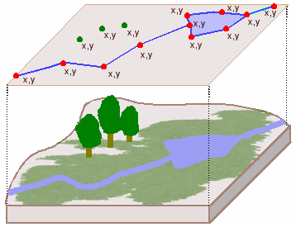
MODELS AND REPRESENTATIONS OF THE REAL WORLD

Slide 4
GEOGRAPHIC PHENOMENA
Deﬁning geographic phenomena
A GIS operates under the assumption that the relevant spatial phenomena occur in a two- or three-dimensional Euclidean space, unless otherwise speciﬁed.
Euclidean space can be informally deﬁned as a model of space in which locations Euclidean space are represented by coordinates—(x,y) in2D;
(x,y,z) in3D—and distance and direction can deﬁned with geometric formulas. In the 2D case, this is known as the Euclidean plane, which is the most common Euclidean space in GIS use.

Slide 5
GEOGRAPHIC PHENOMENA
Deﬁning geographic phenomena
We might deﬁne a geographic phenomenon as a manifestation of an entity or process of interest that:
  Can be named or described,
  Can be geo-referenced, and
  Can be assigned a time (interval) at which it is/was present.

Slide 6
GEOGRAPHIC PHENOMENA
Deﬁning geographic phenomena
The relevant phenomena for a given application depends entirely on one’s objectives.
For instance,
  in water management, the objects of study might be river basins, agro-ecologic units,
  measurements of actual evapotranspiration, meteorological data, ground water levels, irrigation levels, water budgets and measurements of total water use.
  Note that all of these can be named or described, Objectives of the application georeferenced and provided with a time interval at which each exists.
  In multipurpose cadastral administration, the objects of study are different: houses, land parcels, streets of various types, land use forms, sewage canals and other forms of urban infrastructure may all play a role.
  Again, these can be named or described, georeferenced and assigned a time interval of existence.

Slide 7
GEOGRAPHIC PHENOMENA
Types of geographic phenomena
  Firstly, In order to be able to represent a phenomenon in a GIS requires us to state what it is, and where it is.
  We must provide a description—or at least a name—on the one hand, and a georeference on the other hand.
  Secondly, some phenomena manifest themselves essentially everywhere in the study area, while others only do so in certain localities.
  If we deﬁne our study area as the equatorial Paciﬁc Ocean, we can say that Sea Surface Temperature Fields can be measured anywhere in the study area.
Three Types:
Geographic Fields
Geographic Objects
Boundaries

Slide 8
Geographic Fields
A (geographic) ﬁeld is a geographic phenomenon for which, for every point in the study area, a value can be determined.
Some common examples of geographic ﬁelds are
  air temperature,
  barometric pressure and
  elevation.
These ﬁelds are in fact continuous in nature.
Examples of discrete ﬁelds are land use and soil classiﬁcations.

Slide 9
Geographic Fields
Fields can be discrete or continuous.
In a continuous ﬁeld, the underlying function is assumed to be ‘mathematically smooth’, meaning that the ﬁeld values along any path through the study area do not change abruptly, but only gradually.
Good examples of continuous ﬁelds are air temperature, barometric pressure, soil salinity and elevation.
Continuity means that all changes in ﬁeld values are gradual.
A continuous ﬁeld can even be differentiable, meaning we can determine a measure of change in the ﬁeld value per unit of distance anywhere and in any Continuous ﬁelds direction.
For example, if the ﬁeld is elevation, this measure would be slope, i.e. the change of elevation per metre distance; if the ﬁeld is soil salinity, it would be salinity gradient, i.e. the change of salinity per metre distance.
Discrete ﬁelds divide the study space in mutually exclusive, bounded parts, with all locations in one part having the same ﬁeld value.
Typical examples are land classiﬁcations, for instance, using either geological classes, soil type, land use type, crop type or natural vegetation type.

Slide 10
Geographic Fields : Data types and values
Data types used in a GIS and in computer programming include character strings, integers, floating points or real numbers, dates and time intervals. Each field in an attribute table is defined with a data type, which applies to the domain of the field.
  Nominal data values
  Ordinal data values
  Interval data values
  Ratio data values

Slide 11
Geographic Fields : Data types and values
Another method is to define attribute data by measurement scale. The measurement scale concept groups attribute data into nominal, ordinal, interval and ratio data.
(I) Nominal Data: - Nominal data describe different kinds of different categories of data such as land use types or soil types.
(II) Ordinal Data: - Ordinal data differentiate data by ranking relationship. For example-cities may be grouped into large, medium and small cities by population size.
(III) Interval Data: - Interval data have known intervals between values such as temperature reading. For example- a temperature reading of 700 F is warmer than 600 F by 100 F.
(IV) Ratio Data: - Ratio data are the same as interval data except that ratio data are based on a meaningful or absolute zero value. Population densities are an example of ratio data, because a density of 0 is an absolute zero.

Slide 12
Geographic objects
Geographic objects populate the study area, and are usually well distinguished, discrete, and bounded entities. The space between them is potentially ‘empty’ or undetermined.
A simple rule-of thumb is that natural geographic phenomena are usually ﬁelds, and man-made phenomena are usually objects.
Such objects are usually easily distinguished and named, and their position in space is determined by a combination of one or more of the following parameters:
  Location (where is it?),
  Shape (what form is it?),
  Size (how big is it?), and
  Orientation (in which direction is it facing?)

Slide 13
Geographic objects
How we want to use the information about a geographic object determines which of the four above parameters is required to represent it.
For instance, in an in-car navigation system, all that matters about geographic objects like petrol stations is where they are. Thus, location alone is enough to describe the min this particular context, and shape, size and orientation are not necessarily relevant.
In the same system, however, roads are important objects, and for these some notion of location (where does it begin and end), shape(how many lanes does it have), size (how far can one travel on it) and orientation (in which direction can one travel on it) seem to be relevant information components.

Slide 14
Geographic objects
It is sometimes useful to view geographic phenomena at this more aggregated level and look at characteristics like coverage, connectedness, and capacity. For example:
Which part of the road network is within 5 km of a petrol station? (A coverage question)
What is the shortest route between two cities via the road network? (A connectedness question)
How many cars can optimally travel from one city to another in an hour? (A capacity question)

Slide 15
Boundaries
A line separating adjacent political entities, such as countries or districts, adjacent tracts of privately-owned land, such as parcels, or adjacent geographic zones, such as ecosystems.
A boundary is a line that may or may not follow physical features, such as rivers, mountains, or walls.
Two types:
  Crisp
  Fuzzy

Slide 16
COMPUTER REPRESENTATION OF GEOMETRIC INFORMATION
A GIS data model enables a computer to represent real geographical elements as graphical elements.
Two representational models are dominant;
  Raster (grid-based) and vector (line-based):
  Raster. A raster representation also relies on tessellation: geometric shapes that can completely cover an area.
  Vector. The concept assumes that space is continuous, rather than discrete, which gives an infinite (in theory) set of coordinates.

Slide 17
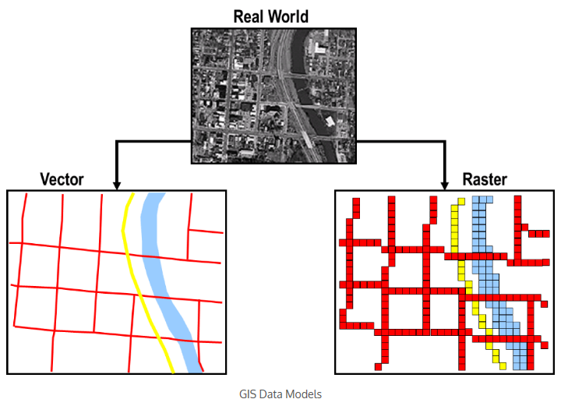
COMPUTER REPRESENTATION OF GEOMETRIC INFORMATION

Slide 18
RASTER BASED REPRESENTATION
Raster. Based on a cellular organization that divides space into a series of units. Each unit is generally similar in size to another.
Grid cells are the most common raster representation.
Features are divided into cellular arrays and a coordinate (X,Y) is assigned to each cell, as well as a value.
A raster representation also relies on tessellation: geometric shapes that can completely cover an area.
Although many shapes are possible (e.g. triangles and hexagons), the square is the most commonly used.
Resolution is an important concern in raster representations.
For a small grid, the resolution is coarse but the required storage space is limited.
For a large grid the resolution is fine, but at the expense of a much larger storage space.

Slide 19
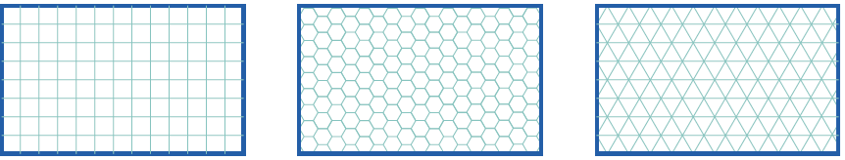
RASTER BASED REPRESENTATION: Regular Tessellations
In a regular tessellation, the cells are the same shape and size.
field attribute value assigned to a cell is associated with the entire area occupied by the cell.
The three most common regular tessellation types: square cells, hexagonal cells, and triangular cells.
These tessellations are known under various names in different GIS packages, but most frequently as rasters.

Slide 20
RASTER BASED REPRESENTATION: Irregular Tessellations
more adaptive to geographic phenomena
region Quadtree
It is based on a regular tessellation of square cells, but takes advantage of cases where neighbouring cells have the same field value, so that they can together be represented as one bigger cell.
It shows a Quadtrees small 8X8 raster with three possible field values: white, green and blue.
The quadtree that represents this raster is constructed by repeatedly splitting up the area into four quadrants, which are called NW, NE, SE, SW
The procedure produces an upside-down, tree-like structure, known as a quadtree.

Slide 21
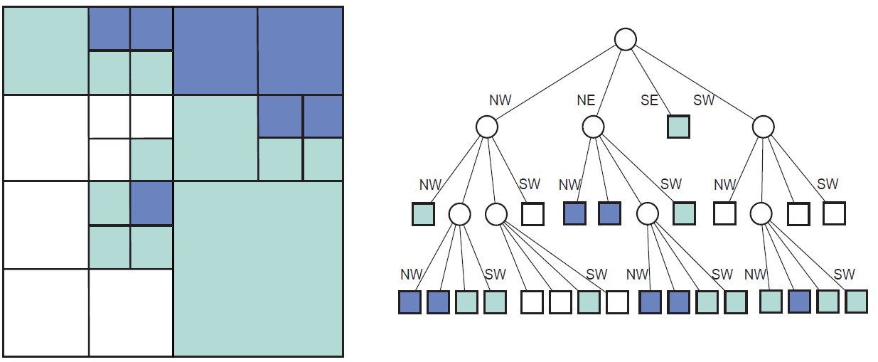
RASTER BASED REPRESENTATION: Irregular Tessellations
Quadtree Representation

Slide 22
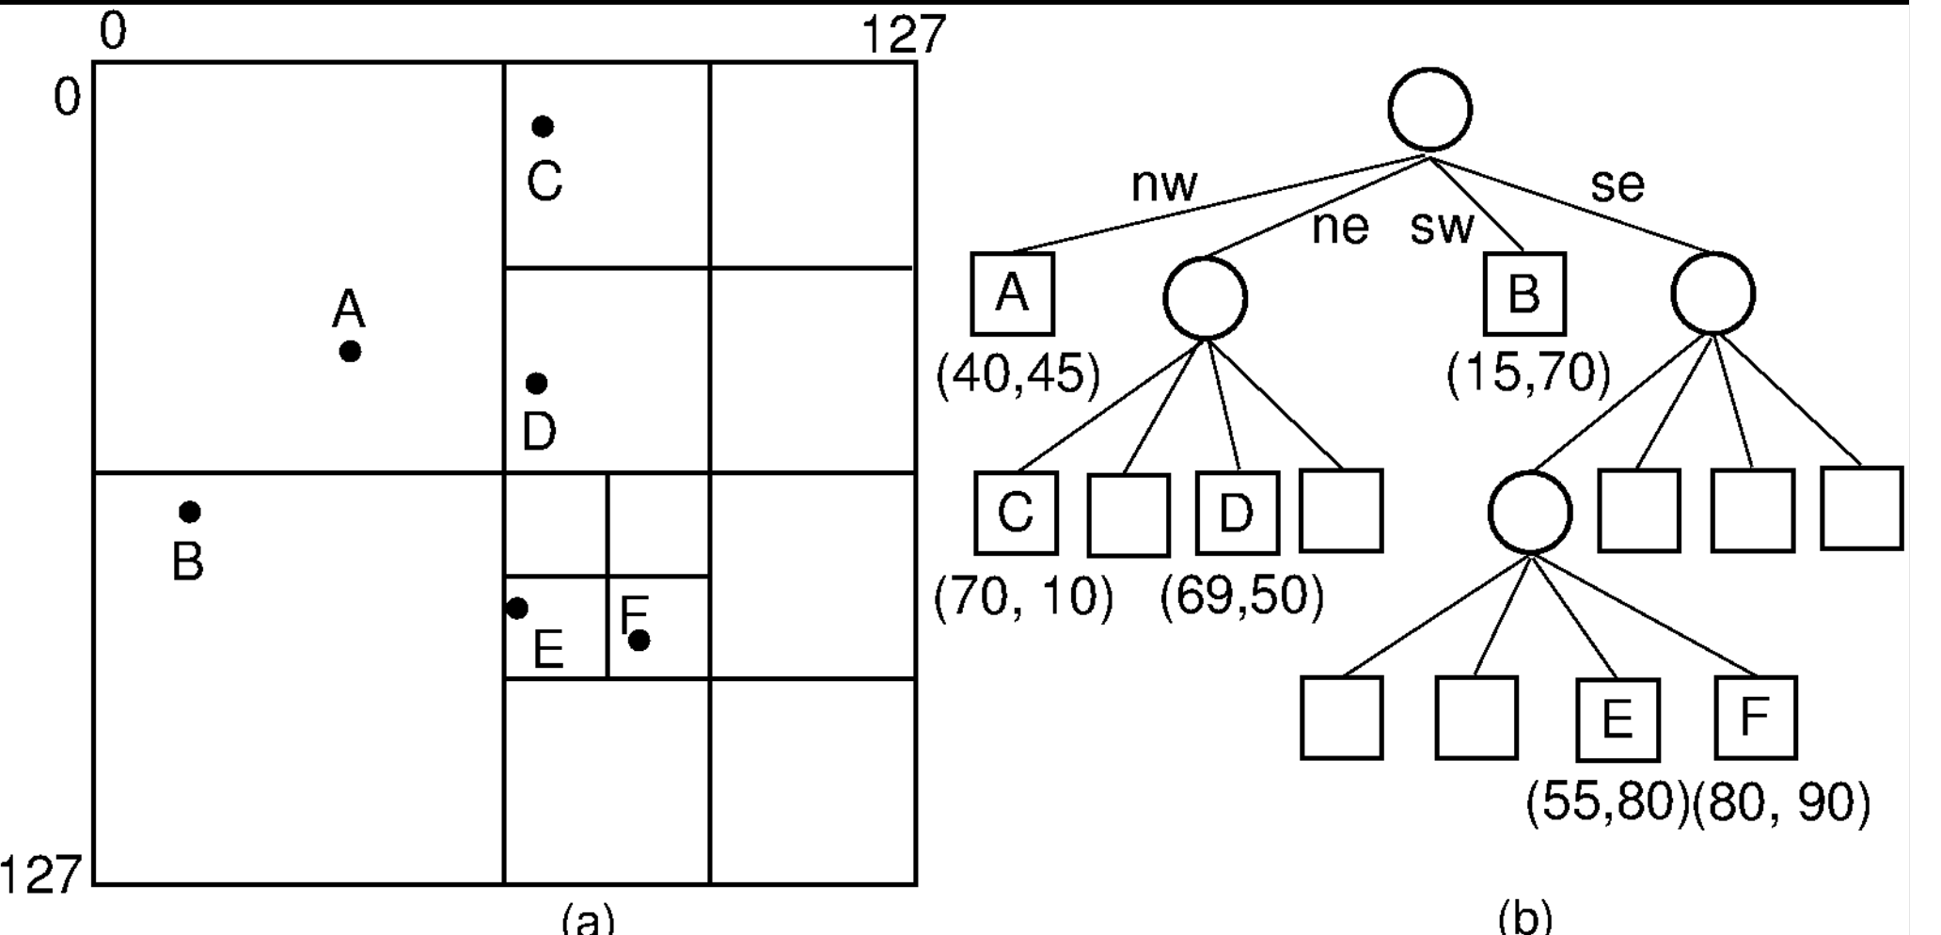
RASTER BASED REPRESENTATION: Irregular Tessellations
Quadtree Representation

Slide 23
VECTOR BASED REPRESENTATION
Vector. The concept assumes that space is continuous, rather than discrete, which gives an infinite (in theory) set of coordinates.
A vector representation is composed of three main elements: points, lines and polygons.
  Points are spatial objects with no area but can have attached attributes since they are a single set of coordinates (X and Y) in a coordinate space.
  Lines are spatial objects made up of connected points (nodes) that have no width.
  Polygons are closed areas that can be made up of a circuit of line segments. The real world is represented by a series of lines (roads and highway) and one polygon (the river).
A real-world entity could be represented by different types of vector features depending on the map scale used in an application (e.g. a road can be represented as a line at a smaller scale or as a polygon at a larger scale.)

Slide 24
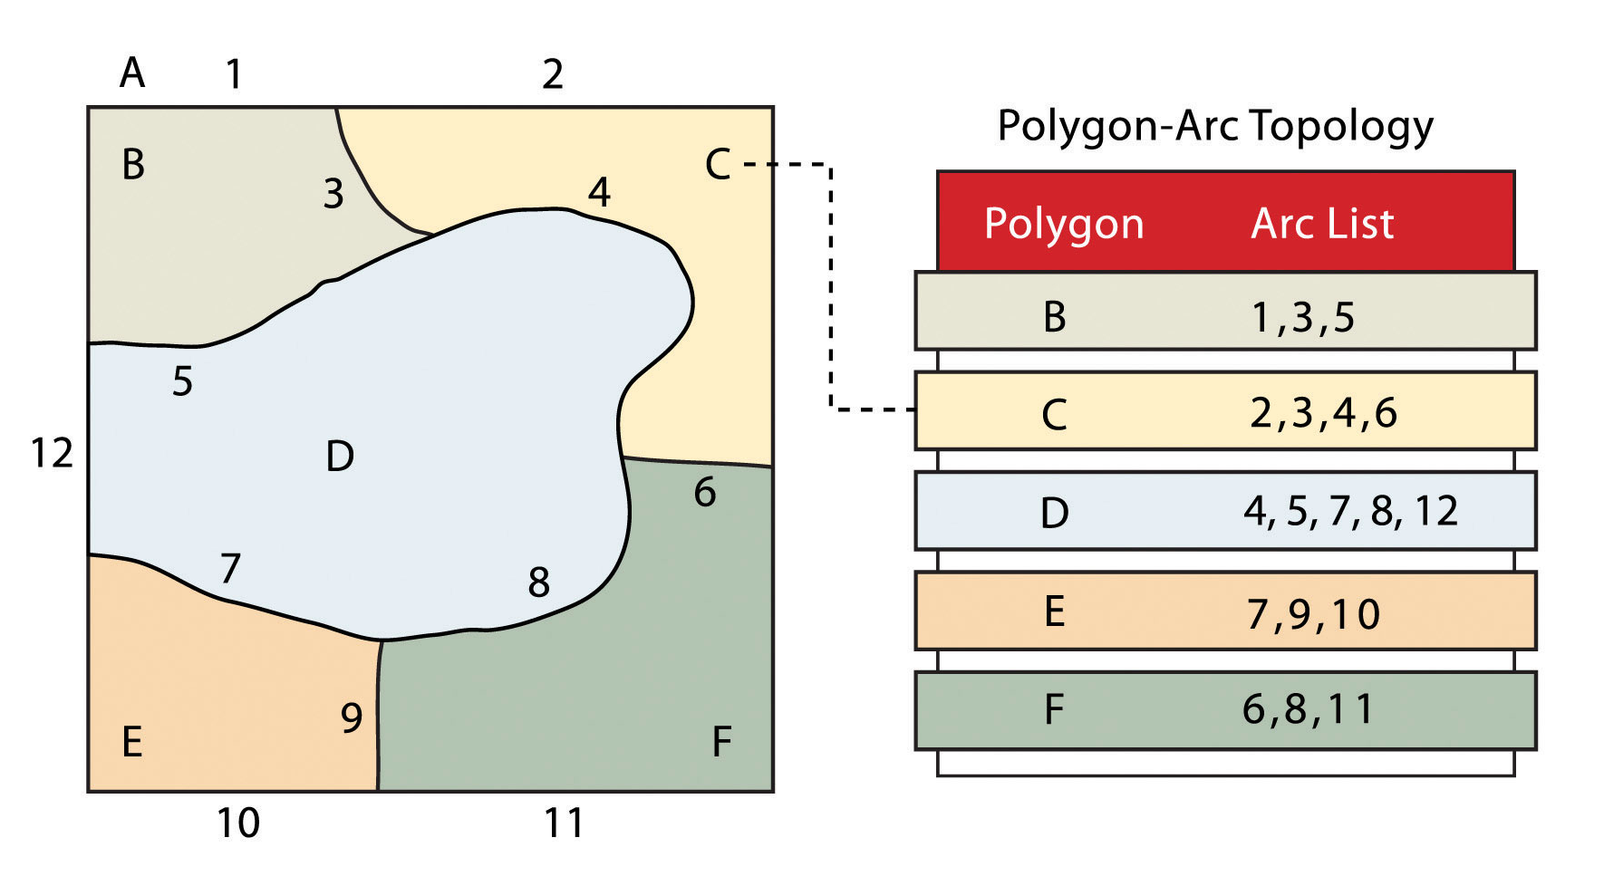
VECTOR BASED REPRESENTATION

Slide 25
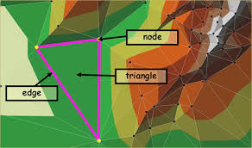
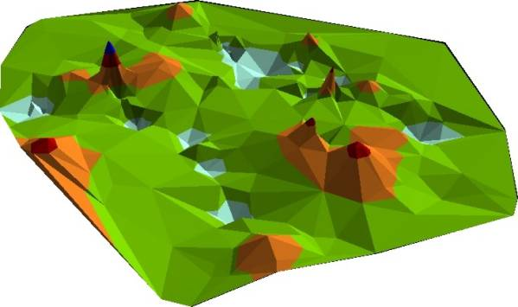
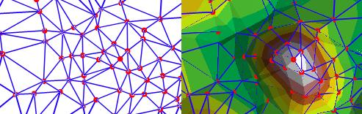
VECTOR BASED REPRESENTATION: TIN
Triangulated Irregular Networks (TIN)
Approximates the terrain with a set of non-overlapping triangles, is made of nodes(points) and edges (lines)

Slide 26
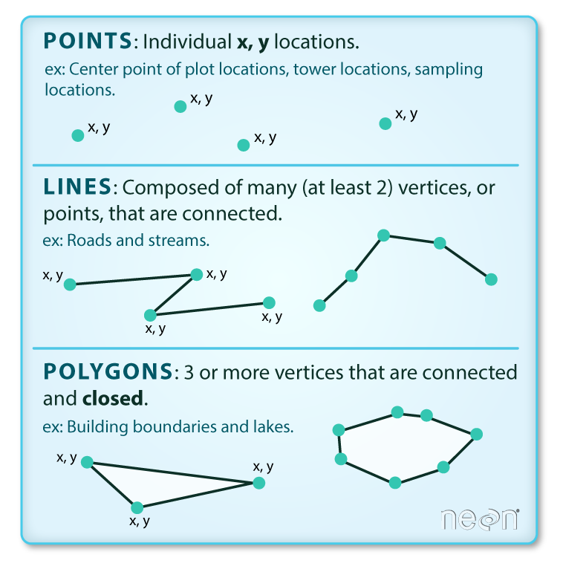
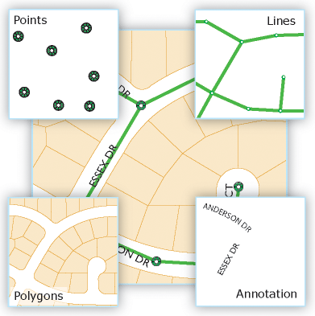
VECTOR BASED REPRESENTATION

Slide 27
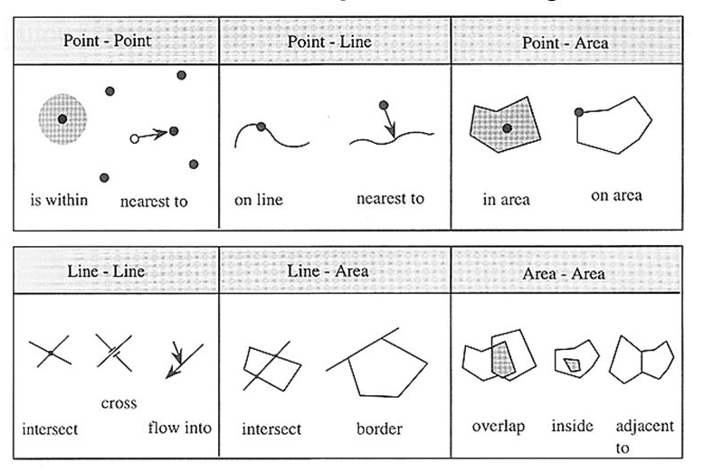
TOPOLOGY AND SPACIAL RELATIONSHIPS

Slide 28
TOPOLOGY AND SPACIAL RELATIONSHIPS
Topology deals with spatial and structural properties of geometric objects, independent of their extension, type, or geometric form.
Among the types of topological properties of objects there are: the number of dimensions an object has or the relationships that exist between objects.
All topological properties are invariant to any continuous deformation of space.
The topology simplifies analysis functions, for examples: joining adjacent areas with similar properties.
It is important to distinguish between vector data formats and raster data formats.
For example, imagine an area represented by a vector data model: it is composed of a border, which separates the interior from the exterior of the surface. The same area represented by a raster data model consists of several grid cells.
There is no border existing as a separating line. Thus, the algorithms implemented for vector data models are not valid for raster data models. In the following example, we only show topological operations in vector data models.

Slide 29
TOPOLOGY AND SPACIAL RELATIONSHIPS
The basic idea is based on the concept that each element is composed of a boundary (b), an interior (i), and an exterior (e). The concept of interior, boundary and complement (exterior) are defined in the general topology.
Boundary
  The boundary consists of points or lines that separate the interior from the exterior. The edge of a line consists of the endpoints. The boundary of a polygon is the line that defines the perimeter.
Interior
  The interior of an object consists of points, lines or areas that are in the object but do not belong boundary.
Complement
  The complement, also called exterior, consists of the points, lines and areas which are not in the object.

Slide 30
TOPOLOGY AND SPACIAL RELATIONSHIPS
Disjoint
  There is no intersection area between object A and object B. Test for disjoint.
Meet
  Object A and object B meet at the boundary. The boundaries meet, but not the interior. Two geometry objects meet if the boundaries touch. Test for touch.
Overlap
  Object A and object B overlap. Test for intersect (inversion of disjoint).
Contains
  Object A contains object B. Test whether the initial geometry object encloses a different geometry object. The interior and the boundary of an object are completely inside of the other object.

Slide 31
TOPOLOGY AND SPACIAL RELATIONSHIPS
Inside
  Object B lies inside object A. It is the opposite of "contain". If A is inside B, then B contains A.
Covers
  Object A covers object B. The interior of an object is completely inside the other object and the boundaries intersect.
Covered by
  Object B is covered by object A. It is the opposite of "covers". If A is covered by B, then B covers A.
Equal
  Object B and object A match. Test for equality of the initial geometry object and a different geometry object.

Slide 32
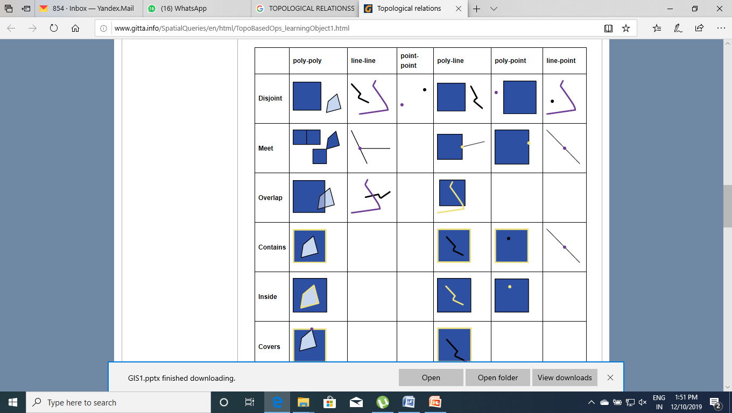
TOPOLOGY AND SPACIAL RELATIONSHIPS

Slide 33
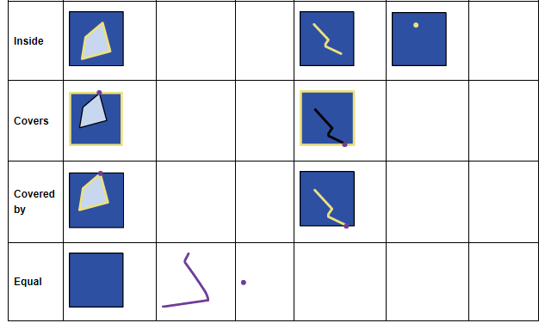
TOPOLOGY AND SPACIAL RELATIONSHIPS

Slide 34
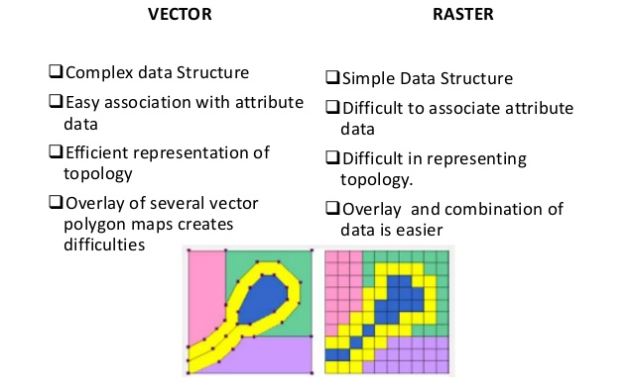
REPRESENTATION OF GEOGRAPHIC FIELDS AND OBJECTS

Slide 35
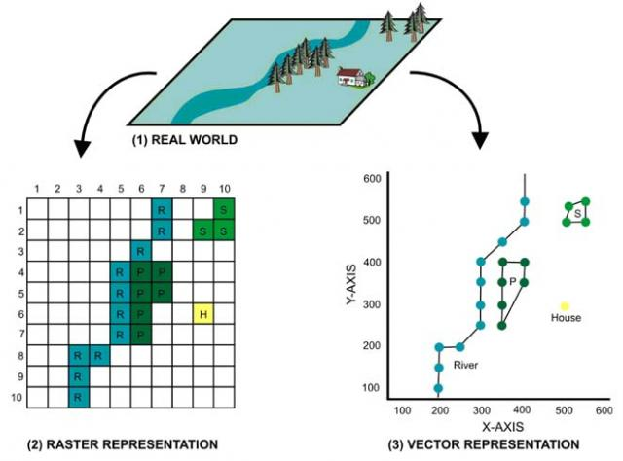
REPRESENTATION OF GEOGRAPHIC FIELDS AND OBJECTS

Slide 36
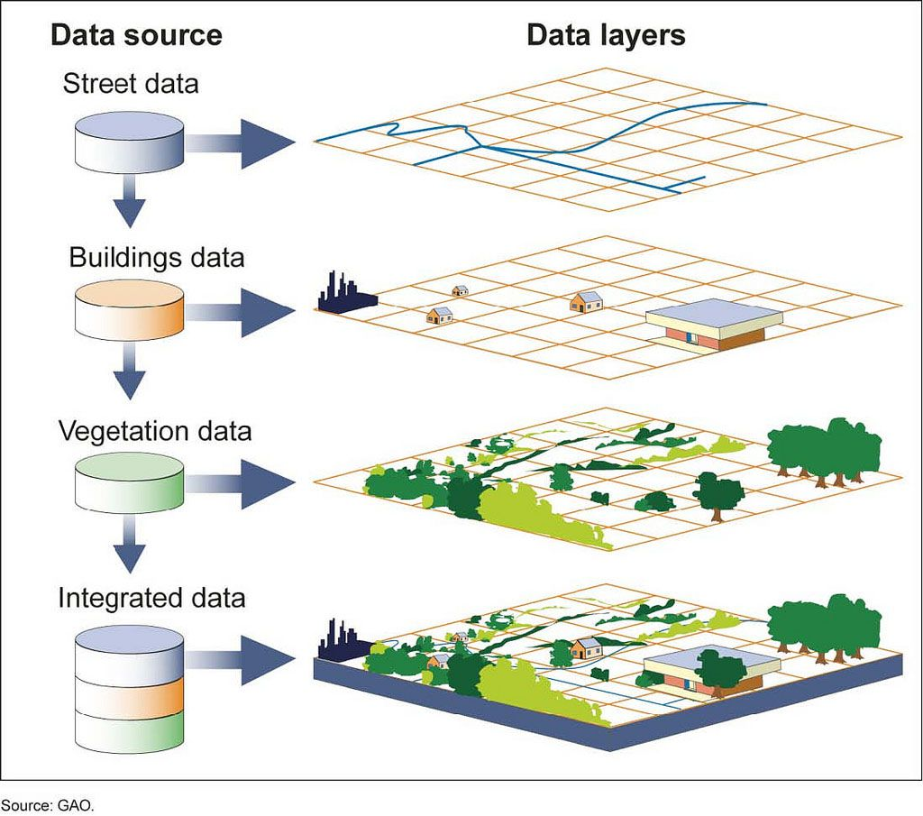
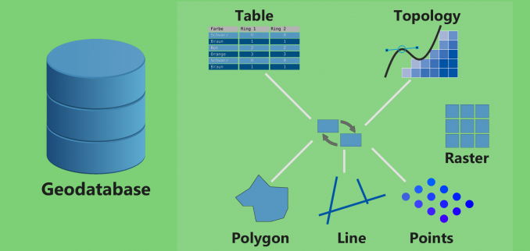
ORGANISING AND MANAGING SPACIAL DATA

Slide 37
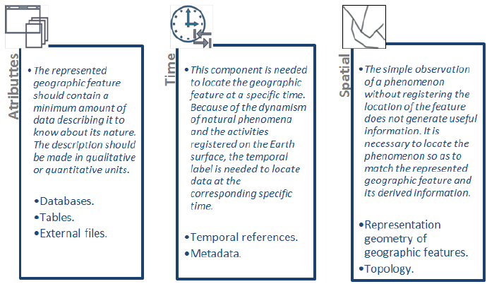
THE TEMPORAL DIMENTION

Slide 38
THE TEMPORAL DIMENTION
although the vast majority of GISs currently work only in two dimensions, across the plane, certain applications require the addition of other dimensions, namely time or elevation/depth
  most geological applications require a consideration of attributes in the vertical dimension as well as the horizontal ones
  temporal variations are important in many economic and social studies
  oceanographic and meteorological models need to consider variations both in the vertical and the temporal dimensions
  time dependence adds a third dimension to spatial data, just as the vertical dimension does
  computer science deals with time dependence of records in databases
  records may be valid only for limited times the geographical cases are more complex
  objects may have limited existence, but may also move, change shape, and change attributes

Slide 39
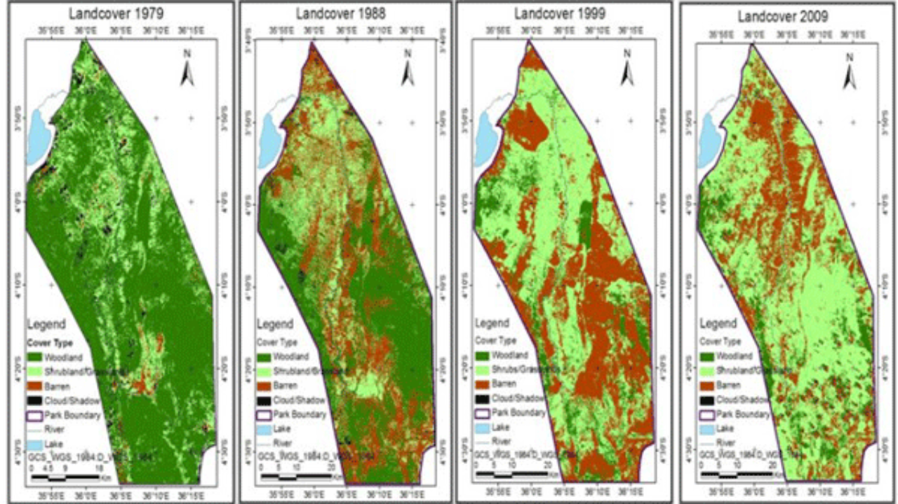
THE TEMPORAL DIMENTION

Slide 40
THE TEMPORAL DIMENTION
Kind of questions involves time include:
  Where and when did something happen?
  How fast did this change occur?
  In which order did the change happen?
Types:
  Discrete and continuous time
  Valid time and transaction time
  Linear, branching and cyclic time
  Time granularity
  Absolute and relative time.

Slide 41
THANK YOU!
TYBSC IT SEM VI
PROF. ARTI GAVAS
ANNA LEELA COLLEGE OF COMMERCE AND ECONOMICS,
SHOBHA JAYARAM SHETTY COLLGE FOR BMS, KURLA

